Slide 1
London Borough Prices
- Omi

Slide 2
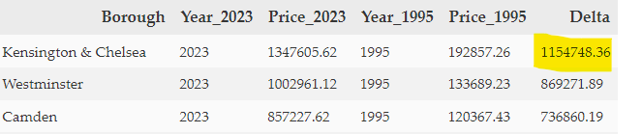
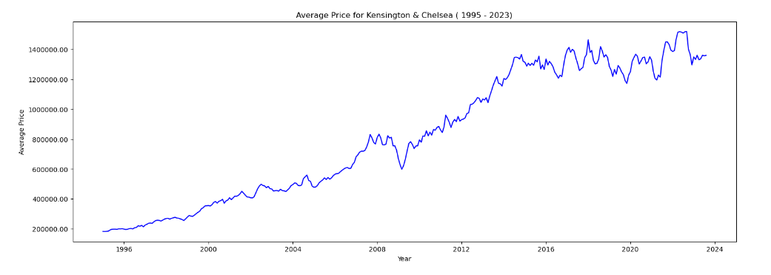
Which borough is the most expensive?
The borough with the highest price and biggest increase is Kensington and Chelsea which saw an increase of over 1 million £

Slide 3
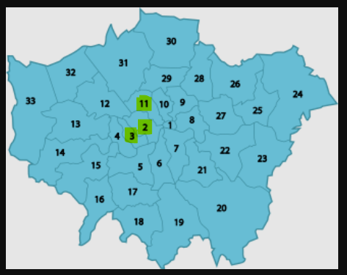
Interesting Trends
The top three boroughs which saw the biggest increase in price are all located in Central London

Slide 4
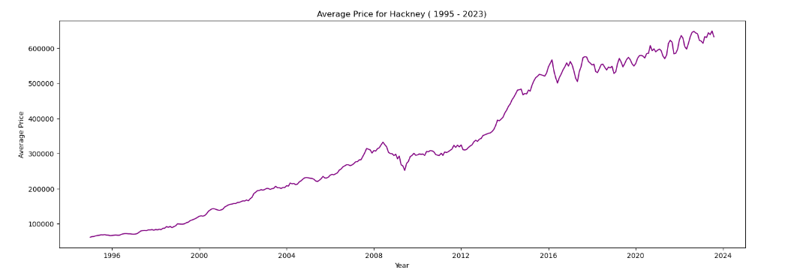
Interesting Trends
The borough with the biggest price increase from 1998 to 2018, Hackney is 7th overall

Slide 5
Things to dig deeper
Which Borough is expected to give the biggest return if we buy a house in 2023 and sell in 5 years?
Did all boroughs see a dip in housing prices between 2008 and 2012

